Slide 1

Kafka
Message Order

Slide 2
Agenda
3 Rules of Kafka Message Order
The Problem
3 Partial Solutions
How to Handle Message Order

Slide 3
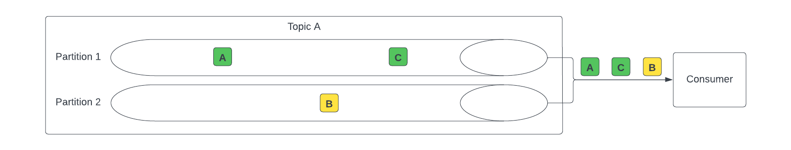
3 Rules of Kafka Message Order
Messages within a partition will be consumed in the order they were persisted to the partition.
Messages across partitions may be consumed out of order even within the same topic

Slide 4
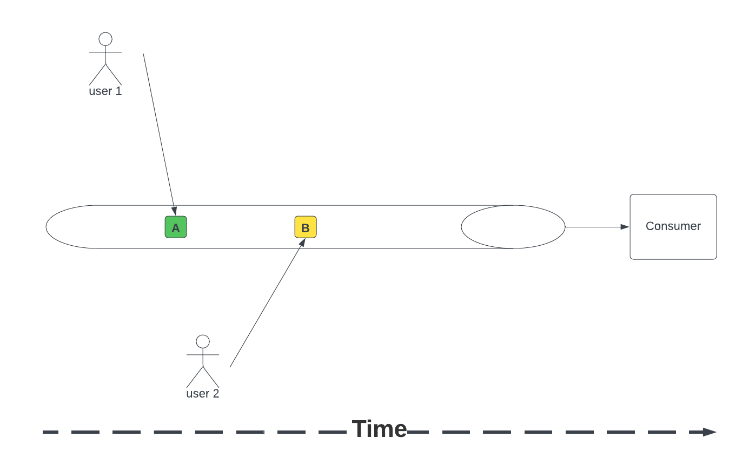
The Problem

Slide 5
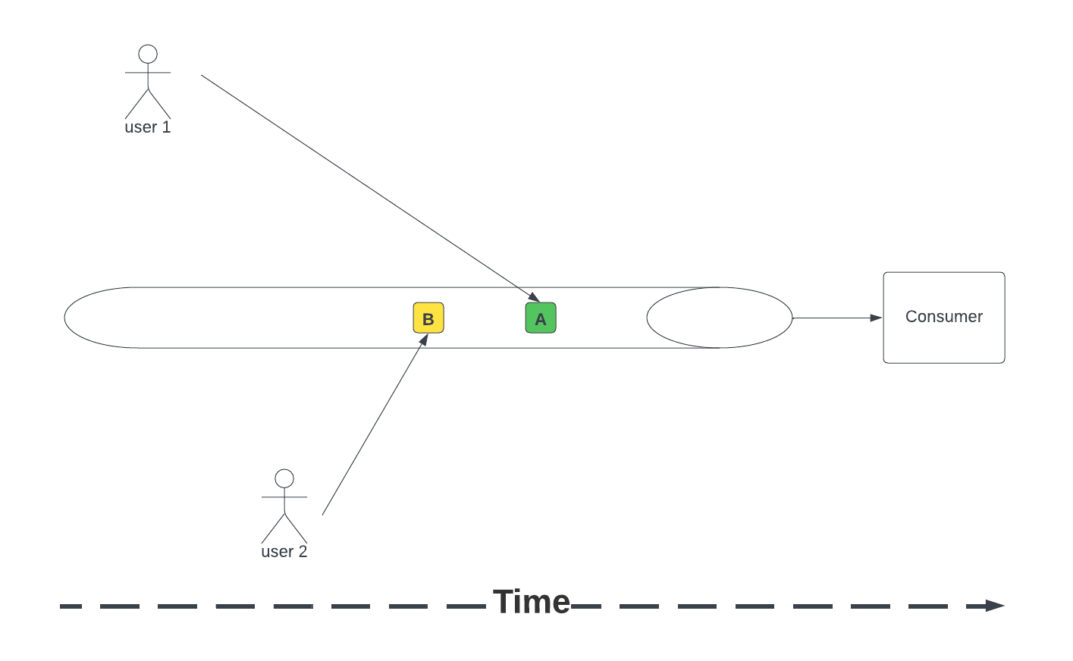
The Problem

Slide 6
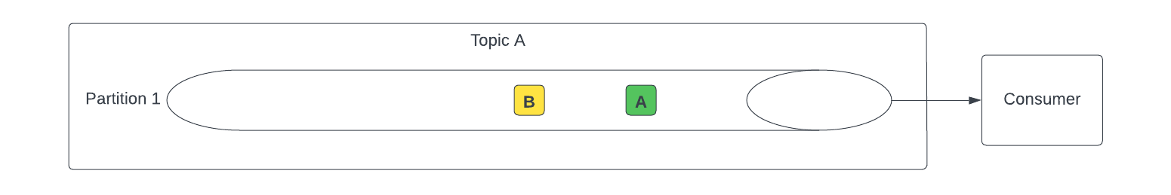
Kafka Message Order
Messages are not guaranteed to be consumed in the order they were published from the client even within a single partition

Slide 7

The Problem
There is no single perfect way to solve all message order needs for all systems and use cases.
This is not a Kafka problem. This issue exists in all data systems and is rooted in the physics of distributed systems.
…and all systems if you include the user context are distributed data systems…;)

Slide 8
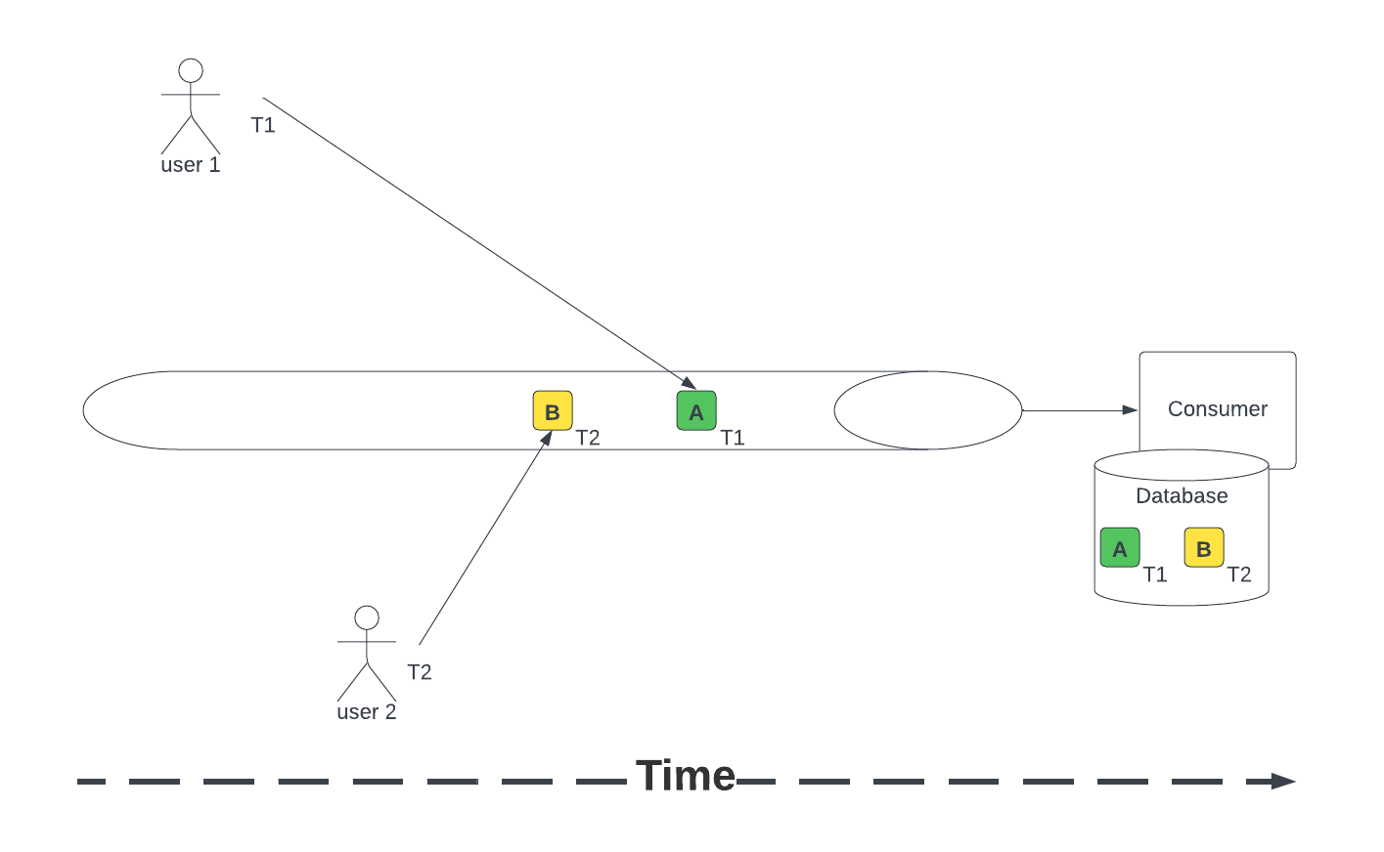
Solution 1 – Time Stamp

Slide 9
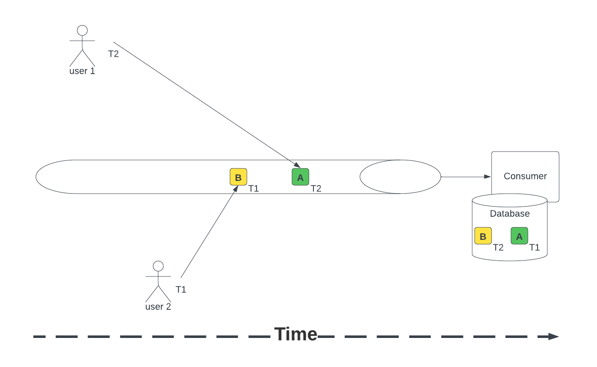
Solution 1 – Time Stamp Problem

Slide 10
Solution 1 – Time Stamp Problem
Computer timestamps are not perfect even though they try to stay in sync with NIST via NTP sync. There are always small differences in time between systems.
Some systems may have been manipulated by the user and be wildly off on time (several hours / days). This is rare with modern operating systems.

Slide 11
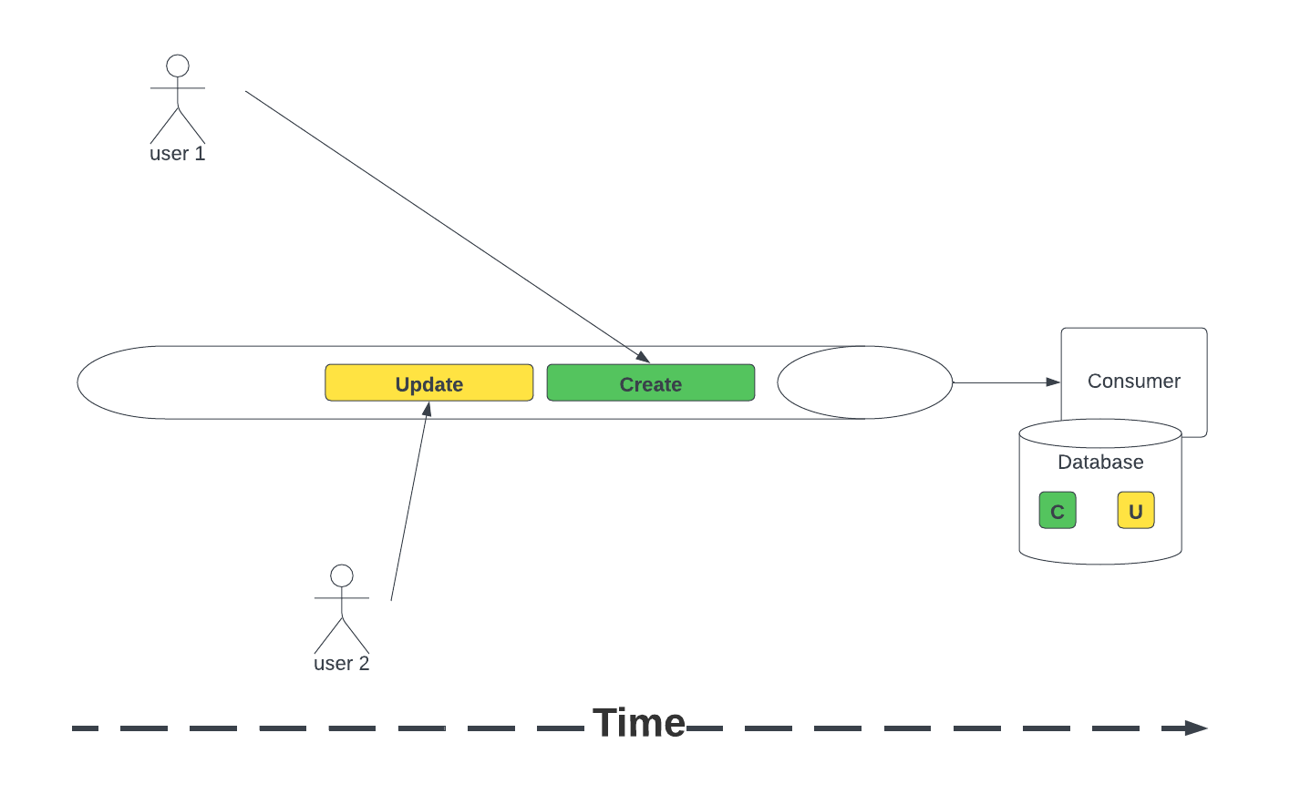
Solution 2 – Logical Order

Slide 12
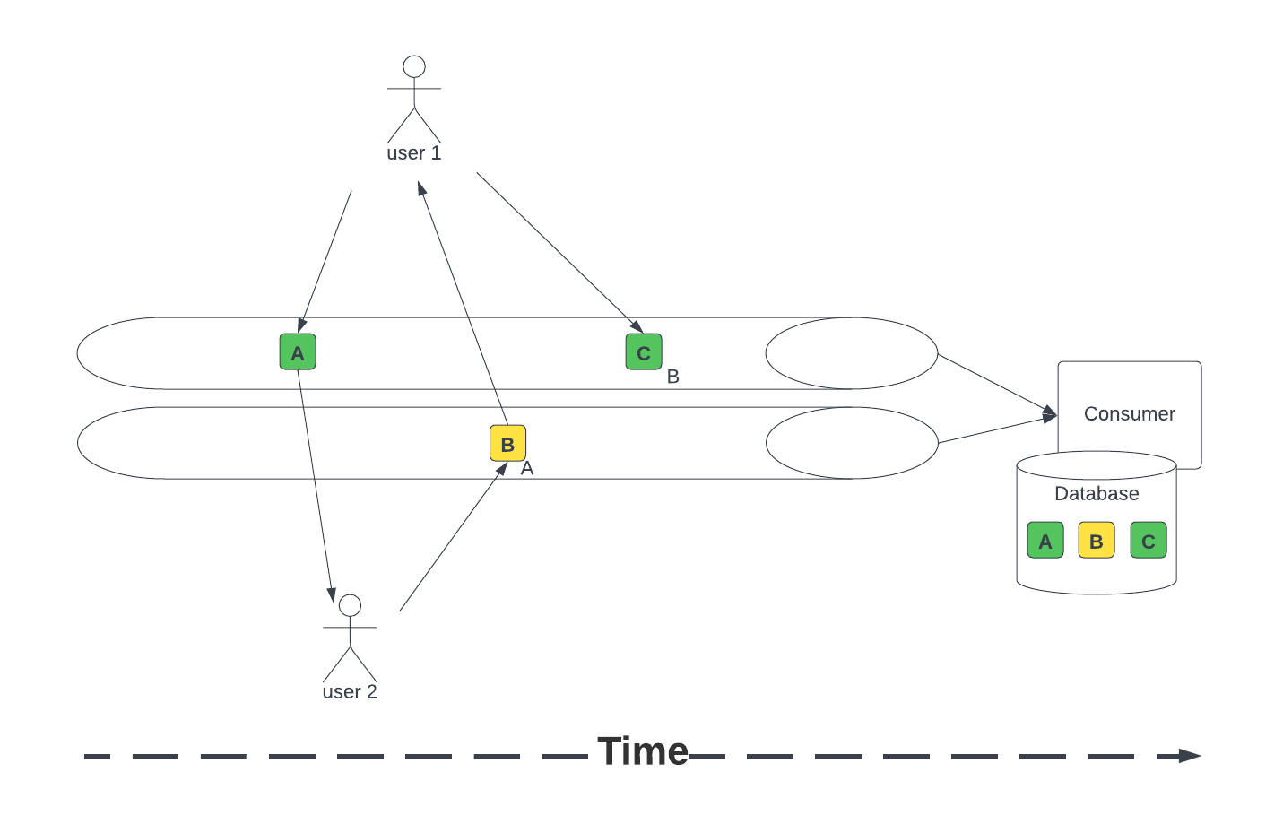
Solution 3 – Conversational

Slide 13
How to Handle Message Order
There are challenges with determine order no matter which technology or approach you take. These challenges are rooted in the physics of distributed systems.
Sometimes message order doesn’t matter
Last message is good enough
Timestamp is good enough
Assumed order by partition is good enough
Where message order does matter, consider creating your own local event source to re-order the messages after you receive them.
Be careful when pushing the consumers need for order onto the producer as a requirement for a partitioning key.
Multiple consumers will have different ordering needs and in a large ecosystem it is unlikely a single partitioning strategy will be sufficient for all consumer ordering needs.

